Slide 1
Updating Traceability Matrix in Excel
Updating Traceability Matrix in ALM
Sign off - using appropriate channels of communication
Environment set up for testing
ETVX of test execution
Test execution considerations, Test execution in multiple cycles
Issues in Test execution,
GUI testing guidelines
· Levels of testing - unit, system, regression, user acceptance
· Test execution process and measurement of the processes

Slide 2
Test Execution

Slide 3
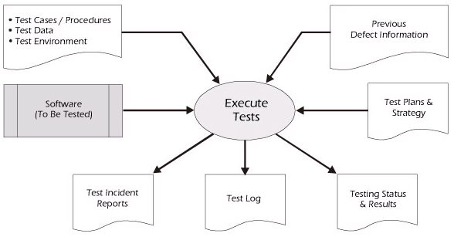
Test Execution - Definition
Test execution is
the process of executing all or a selected number of test cases and observing the results
Notes:
By-products of test execution are test incident reports, test logs, testing status, and results

Slide 4
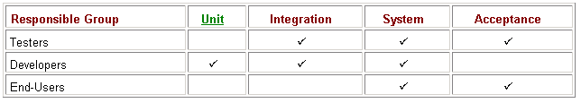
Test Execution – Importance of test levels
By executing Unit, Integration and System Test Cases we can
Validate the system against requirements
Verify code for correctness and conformance to standards
Build the system by having good interfaces among constituents
Understand limitations of the system
Compare system performance
Identify list of open bugs
Have sufficient grounds to decide on releasing the product

Slide 5
Test Reporting

Slide 6
Test Execution Status Report
Test execution status report
This is communication sent out to establish transparency to the QA Team’s activities of the day during the test cycle
Includes information regarding the test cases executed and also about the defects
Information is sent to Development, Environment support team, Business analyst and project teams

Slide 7
Testing Process
Actual output
Test Cases
Test
Data
Test
Results
Test
Reports
Comparison process
Design Test Cases
Prepare Test Data
Run program with test data
Compare results to Test Cases
Test case specifies
Inputs + Pre test state of the product / Software
Expected results (outputs and state)

Slide 8
Testing Guidelines
Testing guidelines are hints that help testers to design effective test cases to reveal defects in the system
Enter all valid data and test the output (normal flow)
Enter invalid data in different fields and test the output (Alternate flows)
Enter invalid data that cause buffers to overflow
Forcing computation results too large or too small

Slide 9
Defects
Verify the existence of defect
Verify that the element under test, the execution environment and test case implementation are consistent with the test case design
Verify and confirm the discrepancy between expected test results and actual test results

Slide 10
Analyze the defect
Analyze the defect
Analyze and resolve variances observed during test execution
Identify root cause for each variance observed
Investigate further and gather more information about symptoms
Analyze features by varying conditions, options and settings to determine severity

Slide 11
Analyze Failures
Analyze failures by conditions, options and settings
Change the condition in which error occurred to determine whether error occurs in the new condition also
Change the configuration settings and determine whether the error occurs in the new configuration setting as well
If the bug seems to be related to test environment, then change the software or hardware and determine whether the error occurs in the new environment

Slide 12
Test Execution Entry and Exit Criteria
Entry Criteria:
A set of decision-making guidelines that indicate whether the project is ready to enter a particular phase of testing.
Exit Criteria:
A set of decision-making guidelines that indicate whether the project is ready to exit a particular phase of testing.
Notes:
Focus: Definition of Entry and Exit Criteria (cont.)
Transition: To understand more the concept of entry and exit criteria, lets have a more detailed discussion by inspecting the criteria specific to a test stage. Let’s take Application Product test as an example.

Slide 13
Test Execution Entry and Exit Criteria
Test Scripts / Procedures
Test Data
Test Environment
Previous Defect Information
Execute Tests
Software
(To be tested)
Test Plan & Strategy
Test Incident Reports
Test Logs
Test Status & Results
Notes:
Focus: Test Execution Entry and Exit diagram
Content:
Input of test Execution are Test scripts / Test Data and Test Environment then Software that is expected to be tested, Defect Prevention Information and lastly the test Plans and Strategy.
Output or By-products of Test Execution are Test Incident reports, Test logs, Testing status, results.
Transition: Let us now go through the Test Execution Entry Criteria.

Slide 14
Test Metrics, Test Reports and Sign Off

Slide 15
Measures and Metrics
Measure – A single unit of measurement, e.g. defect, line of code, person hour, second, inch, etc.
Metric – The combination of two or more measures to provide meaningful information
Objective Measure – A measure that can be obtained by counting
Subjective Measure – A person’s perception of a product or activity
Notes:
Quality and Testing metrics should support project or departmental quality goals. Measure only what you’re really interested in and plan to act upon.
Absolute Values:
Useful when comparing actual vs. planned results at any point in time
“We are exactly 50 modules behind in test readiness.”
Useful when used as a gatekeeper: for example,
“No module may enter test if its cyclomatic complexity exceeds x without review/approval.”

Slide 16
How Do You Know a Measure is Good?
Reliability – two people, same result
Validity – Measures what it is suppose to
Ease of Use and Simplicity
Timeliness – Reported in time to make a difference
Calibration – Movement of metric so it becomes more valid
Notes:
The first 2 are the most likely to be seen.
Recall def. of reliability from software quality factors: customer view-
this one is different and has to do with measurement.
exam, these words could be in multi choice or essay.
Here is how you tell: “With regards to measurement, …..”
2 testers testing test case A, get the same result.
When developer argues with you, saying,
“The defect is because of the way you tested it”
You have failed to prove reliability and validity.
Validity: e.g.: defects in operating system vs defects in the data base

Slide 17
Define Test Measures & Metrics
In order to support the test reporting, it is critical that the correct and useful metrics be established and the data gathered. The process for identifying and gathering the statistics is as follows:
Establish a test measurement team
Inventory existing IT measures
Define a consistent set of measures
Develop desired test metrics
Develop and implement the process for collecting measurement data
Notes:
This is somewhat similar to what was stated before.
The details are in the STBOK.
We are trying to leverage off of what we know from before.

Slide 18
Defining Test Metrics
Test Metrics
A Metric is a quantitative measure of the degree to which a system, system component, or process possesses a given attribute.
Metrics can be defined as Standards of Measurement.
Software Metrics are used to measure the quality of the project.
A Metric is a unit used for describing an attribute.
A Metric is a scale for measurement.

Slide 19
Examples of Test Metrics
Examples
How many defects are identified in a particular module?
How many high priority defects are identified?
How many test cases are executed on an average per day?
What is the test coverage percentage?

Slide 20
Measurement and Metrics
Measurement
A quantitative observation of an attribute or aspect of the software process, product, or project.
E.g. No. of test cases executed, passed, no. of defects
Metrics
Metrics is computed data. It is a ratio of two measures.
Used as meaningful indicators of quality of processes or products
E.g. Test case coverage, % of defects closed, Test case productivity, defect finding productivity

Slide 21
Significance of Metrics
Metrics is significant for measuring the quality of software.
Test Analysts responsibility
Designing test cases
Executing test cases
Log the defects for failed test cases
Re-test the defect and re-execute the failed test case after the defect is resolved

Slide 22
Significance of Metrics
Exact status of the project can be published only if the metrics are captured
Generally the following info is published
1. How many test cases have been designed per requirement?
2. How many test cases are yet to be designed?
3. How many test cases are executed?
4. How many test cases are passed / failed / blocked?
5. How many test cases are not yet executed?
6. How many defects are identified and what is the severity of those defects?
7. How many test cases have failed due to one particular defect?

Slide 23
Significance of Metrics
Based on the metrics, the test lead / manager understands the following key points
Percentage (%) of work completed
Percentage (%) of work yet to be completed
Time to complete the remaining work
Whether the project is going as per the schedule or lagging, and so on

Slide 24
Example of Measurements
# | Testing | Data retrieved during test case development and execution
1 | No. of requirements | 10
2 | Average no. of test cases written per requirement | 20
3 | Total no. of test cases written for all requirements | 200
4 | Total no. of test cases executed | 130
5 | No. of test cases passed | 80
6 | No. of test cases failed | 40
7 | No. of test cases blocked | 10

Slide 25
Example of Measurements
# | Testing | Data retrieved during test case development and execution
8 | Number of Test cases not executed | 70
9 | Total Number of Defects identified | 30
10 | Critical Defects count | 10
11 | High Priority Defects Count | 8
12 | Medium Priority Defects Count | 6
13 | Low Priority Defects Count | 10
14 | No. of defects deferred | 4

Slide 26
Measures Unique to Test
Number of test cases – The number of unique test cases selected for execution.
Number of test cases executed – The number of unique test cases executed, not including re-execution of individual test cases.
Number of test cases passed – The number of unique test cases that currently meet all the test criteria.
Number of test cases failed – The number of unique test cases that currently fail to meet the test criteria.
Number of test cases blocked - The number of distinct test cases that have not been executed during the testing effort due to an application, configuration, or environmental constraint.
Number of test cases re-executed – The number of unique test cases that were re-executed, regardless of the number of times they were re-executed.
Total executions - The total number of test case executions including test re-executions.
Total number of test cases passes - The total number of test case passes, including re-executions of the same test case.
Notes:
Example of metrics unique to testing:
number of test cases executed vs those remaining
Function points measure size
Most likely: Metrics unique, project metrics, size, on exam

Slide 27
Measures Unique to Test
Total failures - The total number of test case failures, including re-executions of the same test case.
Number of first run failures - The total number of test cases that failed on the first execution.
Number of defects found (in testing) – The number of defects uncovered in testing.
Number of defects found by severity – The number of defects as categorized by severity (e.g., critical, high, medium, low)
Number of defects fixed – The number of reported defects that have been corrected and the correction validated in testing.
Number of open defects – The number of reported defects that have not been corrected or the correction has not been validated in testing.
Number of defects found post-testing – The number of defects found after the application under test has left the test phase. Typically this would be defects found in production.
Notes:
Example of metrics unique to testing:
number of test cases executed vs those remaining
Function points measure size
Most likely: Metrics unique, project metrics, size, on exam

Slide 28
Measures Unique to Test
Defect age – The number of days since the defect was reported.
Defect aging – The number of days open (defect closed date – defect open date).
Defect fix time retest – The number of days between the date a corrected defect is released in the new build and the date the defect is retested.
Person days – The number of person days expended in the test effort.
Number of test cycles – The number of testing cycles required to complete testing.
Number of requirements tested – The total number of requirements tested.
Number of passed requirements - Number of requirements meeting success criteria.
Number of failed requirements – Number of requirements failing to meet the defined success criteria
Notes:
Example of metrics unique to testing:
number of test cases executed vs those remaining
Function points measure size
Most likely: Metrics unique, project metrics, size, on exam

Slide 29
Example of Metrics
% of test case execution completed
This metric is used to obtain the execution status of the test cases in terms of Percentage (%)
Percentage (%) Test cases Executed = (Number of Test cases executed / Total Number of Test cases written) * 100
From the above data,
130/200*100 = 65%
65% - Test case executed and 35% - Test cases not executed

Slide 30
Metrics Unique to Test
Percent complete – Number of test cases passed / total number of test cases to be executed.
Test case coverage – Number of test cases executed / total number of test cases to be executed.
Test pass rate – Number of test cases passed / number of test cases executed.
Test failure rate – Number of test cases failed / number of test cases executed.
Tests blocked rate – Number of test cases blocked / total test cases
First run failure rate – Number of first run failures / number of test cases executed.
Percent defects corrected – Number of closed defects / total number of defects reported
Notes:
B
D

Slide 31
Metrics Unique to Test
Percent rework – (Number of total executions – number of test cases executed) / number of test cases executed
Percent bad fixes – (Total failures – first run failures) / first run failures
Defect discovery rate – Total defects found / person days of test effort
Defect removal efficiency – Total defects found in testing / (total defects found in testing + number of defects found post-testing).
Defect density – Total defects found / standard size measure of application under test (size measure could be KLOCs, Function points, Story Points)
Requirements Test Coverage - Number of requirements tested / total number of requirements
Notes:
B
D

Slide 32
Benefits of Metrics
Controlling the project
Monitoring the health of the project
Ensuring project objectives are met
Making data-driven decisions
Identifying areas to drive process improvements
Identifying points to do a root cause analysis
Making prediction based on current metrics

Slide 33
Metrics Life Cycle
Analyze
Communicate
Report
Evaluate

Slide 34
Test Report
The Test Report gives the picture of the Testing done for the project.
Details of the test cases, which are Passed / Failed
Defects, which are still Open / Rejected / In Progress,
and so on are captured here.
It can be manual or can be generated using Test tools.
Only with these collect inputs does the Management
decide if the release can happen or not.

Slide 35
Test Execution Status Report
Test execution status report addresses the following:
Number of test cases planned for that day
Number of test cases executed that day
Number of test cases executed overall
Number of defects encountered that day and their respective states
Number of defects encountered so far and their respective states

Slide 36
Test Execution Status Report
Test execution status report addresses the following:
Number of critical defects that are still open
Environment downtimes, if any
Showstoppers, if any
Attachment of the test execution sheet / Link to the test management tool where the test cases are placed
Attachment to the bug report / link to the defect / test management tool used for incident management

Slide 37
Test Summary Report
Test Summary Report is an important deliverable which is prepared at the end of a Testing project, or rather after Testing is completed.
The prime objective of this document is to explain various details and activities about the Testing performed for the project to the respective stakeholders like senior management, client, etc
As part of Test execution report, daily testing results are shared with involved stakeholders every day. But Test Summary Report provides a consolidated report on the Testing performed so far for the project.

Slide 38
Test Summary Report contd.
Purpose of the document
Short description about objective of preparing the document
Application overview
Brief description of the application tested
Testing scope
Modules / Features in scope and out of scope, types of testing in scope and out of scope, any module not tested due to dependencies, constraints
Metrics
Helps understand test execution results, current state of the build, defects etc

Slide 39
Test Summary Report contd.
Types of testing performed
Describe the various types of Testing performed in a project.
Test environment and tools
Provide details on Test Environment in which the Testing is carried out; Server, Database, Application URL etc
Lessons Learned
This section is used to describe the critical issues faced and their solutions (how they were solved during Testing).
Recommendations
Any workaround or suggestions can be mentioned

Slide 40
Test Summary Report contd.
Best Practices
Activities regarded as best practices during the project can be documented as Value Add to showcase to the Stakeholders.
Exit criteria
Exit Criteria is defined as a Completion of Testing by fulfilling certain conditions like all planned test cases are executed, all Critical defects are Closed, and so on.
Conclusion of sign-off
This section will mention whether the Testing team agrees and gives a Green signal for the application to Go Live or not, after the Exit Criteria was met.
Definitions, Acronyms and Abbreviations
This section mentions the meanings of Abbreviated terms used in this document and any other new definitions.

Slide 41
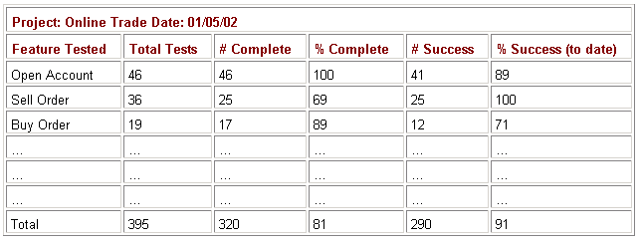
Testing Status - Measuring
The testing status report is often the primary formal communication channel that the test manager uses to inform the rest of the organization of the progress made by the testing team.

Slide 42
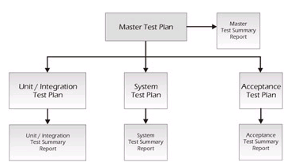
Test Summary - Report
The purpose of the Test Summary Report is to summarize the results of the testing activities and to provide an evaluation based on these results
Notes:
The summary report provides advice on the release readiness of the product and should document any known anomalies or shortcomings in the product. This report allows the test manager to summarize the testing and to identify limitations of the software and the failure likelihood. There should be a test summary report that corresponds to every test plan. So, for example, if you are working on a project that had a master test plan, an acceptance test plan, a system test plan, and a combined unit/integration test plan, each of these should have its own corresponding test summary report
In essence, the test summary report is an extension of the test plan and serves to "close the loop" on the plan

Slide 43
Test Summary Report – IEEE Template
IEEE Std. 829-1998 for Software Test Documentation
Template for Test Summary Report : Contents
Test Summary Report identifier
Summary
Variances
Summary of Results
Resolved Incidents
Unresolved Incidents
Evaluation
Recommendations
Summary of Activities
Approvals
Notes:
Test Summary Report Identifier
The Report Identifier is a unique number that identifies the report and is used to place the test summary report under configuration management.
Summary
This section summarizes what testing activities took place, including the versions/releases of the software, the environment and so forth. This section will normally supply references to the test plan, test-design specifications, test procedures, and test cases.
Variances
This section describes any variances between the testing that was planned and the testing that really occurred. This section is of particular importance to the test manager because it helps him or her see what changed and provides some insights into how to improve the test planning in the future.
Comprehensive Assessment
In this section, you should evaluate the comprehensiveness of the testing process against the criteria specified in the test plan. These criteria are based upon the inventory, requirements, design, code coverage, or some combination thereof. Features or groups of features that were not adequately covered need to be addressed here, including a discussion of any new risks. Any measures of test effectiveness that were used should be reported and explained in this section.
Summary of Results
Summarize the results of testing here. Identify all resolved incidents and summarize their resolution. Identify all unresolved incidents. This section will contain metrics about defects and their distribution (refer to the section on Pareto Analysis in this chapter).
.

Slide 44
Test Results - Reporting
Current Status Test Reports
Final Test Reports
Guidelines for Report Writing
Notes:
44

Slide 45
Test Results - Reporting
Should be a continuous process
In preparing test reporters, answer:
What information do the stakeholders need?
How can testers present that information in an easy-to-understand format?
How can I present the information so that it is believable?
What can I tell the stakeholder that would help in determining what action to take?
Test reporting needs to be sent at pre-defined place using current status reports and at the end of testing using the final test report
Notes:
45

Slide 46
Reporting Test Results: Current Status Test Reports
Need to show the status of testing
These will be used by the testers, test manager, and the software development team
Notes:
46

Slide 47
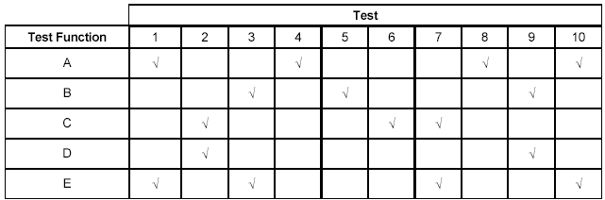
Current Status Reports: Function Test Matrix
Shows which tests must be performed to validate the functions
A low level report that shows the results of each test
Intersections can be color coded or with a number to show status
Test is needed, but not performed
Test is currently being performed
Test was performed and a minor defect noted
Test was performed and a major defect noted
Test complete and function is defect-free for the criteria included in this test
Notes:
47

Slide 48
Current Status Reports: Defect Status Report
One is needed for each defect found by testers
Data can be simple or complex, but these are the minimum recommended:
Defect naming
Defect Severity
Defect Type
It is to describe the defect and give the current status of that defect
Notes:
48

Slide 49
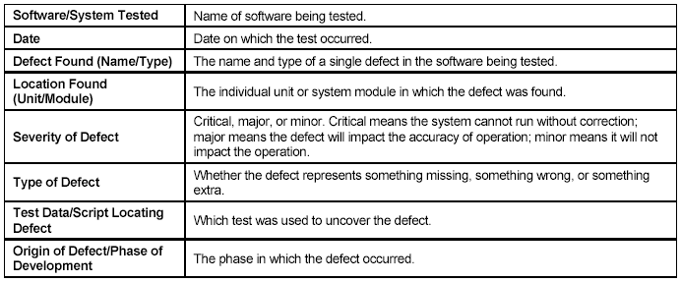
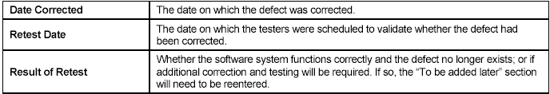
Current Status Reports: Defect Status Report

Slide 50
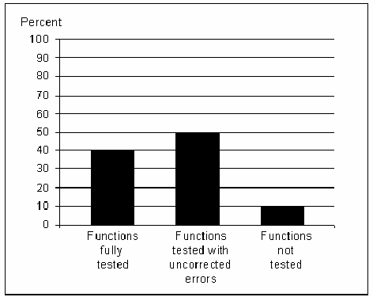
Current Status Reports - Functional Testing Status Report
Should contain the percent of:
Functions that have been fully tested
Functions that have been tested, but contain errors
Functions that have not been tested
It is to show the progress of testing
How many concerns are generated by this report depend upon what stage the application is in
Notes:
50

Slide 51
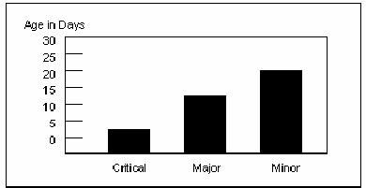
Current Status Reports : Average Age of Uncorrected Defects by Type
Used to show the breakdown of the gap from Defects Uncovered versus Corrected Gap Timeline Report
Organizations should have guidelines for how long defects at each level should be allowed in the system, before they are corrected
Notes:
51

Slide 52
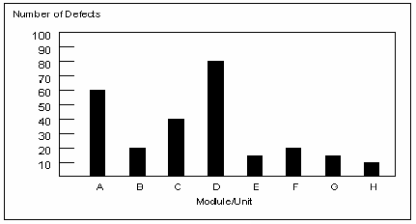
Current Status Reports: Defect Distribution Report
Used to explain how defects are distributed among the modules/units being tested
A variation could be what test found the defects
Functions with high defect count normally have an architecture issue
Notes:
52

Slide 53
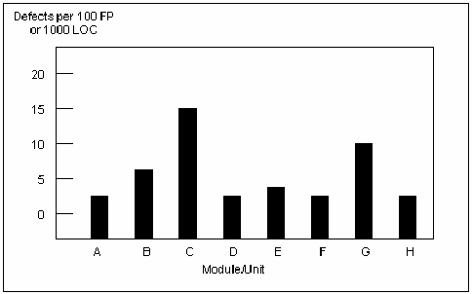
Current Status Reports: Relative Defect Distribution Report
Used to normalize the defect distribution presented
Can be by function points or lines of code
Permits comparison of defect density among the modules/units
Notes:
53

Slide 54
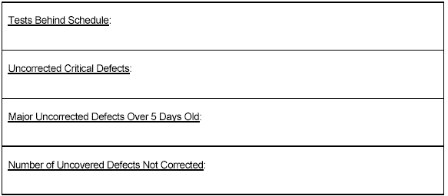
Current Status Reports: Testing Action Report
Used to summarize the action report prepared by the test team
Helps managers see the state of testing and defect fixes
Notes:
54

Slide 55
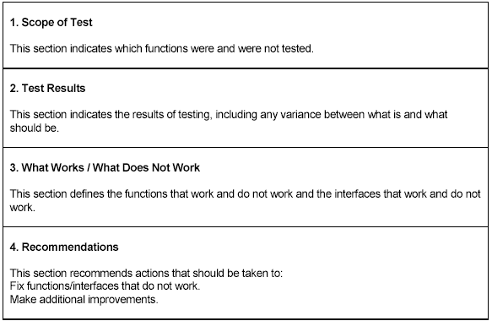
Current Status Reports - Individual Project Component Test Results
Generated when a tester has its testing completed for a component
Notes:
55

Slide 56
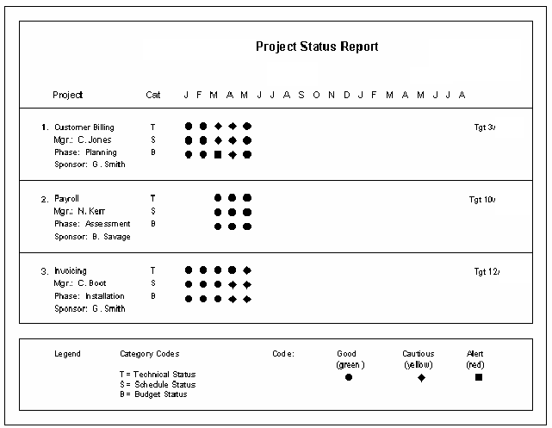
Current Status Reports: Summary Project Status Report
Used to provide general information about the application and uses graphics to show the status for each component
Should contain:
Report Date Information
Project Information
Timeline Information
Legend Information
Notes:
56

Slide 57
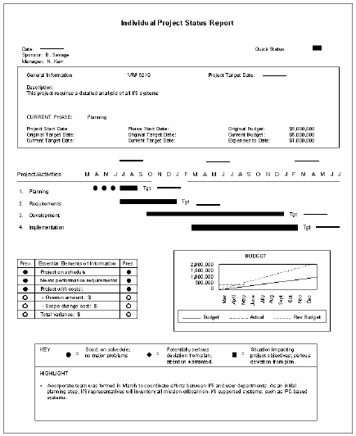
Current Status Reports: Individual Project Status Report
Provides information for a specific project component
Should contain:
Project Information
General Project Information
Project Activities Information
Timeline for measuring each phase
Future dates for expected completion
Essential Elements Information
Legend Information
Project Highlights Information
Notes:
57

Slide 58
Reporting Test Results - Final Test Reports
Should be prepared after each level of testing
May include Unit, Integration, System, and Acceptance test reporting
Should report the results of testing as defined by the test plan
Should contain:
Definition of the scope of testing
Test results
Conclusions and recommendations
Objectives:
Inform the developers what works and what does not work
Provide information to the users of the software system so that they can determine whether or not the system is ready for production
After implementation, help the project trace problems in the event that the application breaks in production
Use the test results to analyze the test processes to make it run smoother
Notes:
58

Slide 59
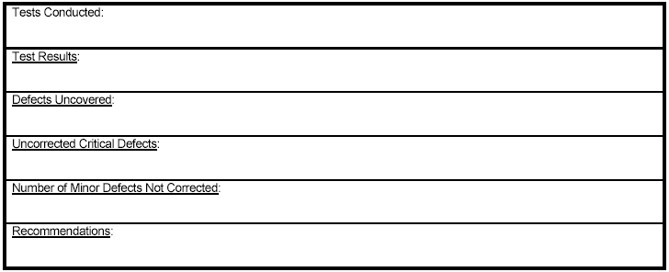
Final Test Reports: Unit Test Report
Unit is usually tested by the developer
Notes:
59

Slide 60
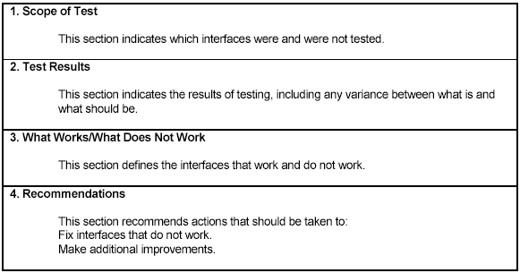
Final Test Results: Integration Test Report
Follows the same format as unit test report, except it focuses on the interfaces
Notes:
60

Slide 61
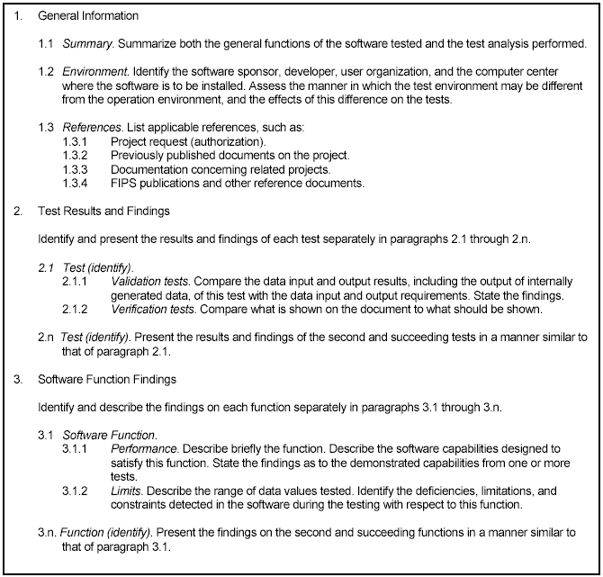
Final Test Reports: System Test Report
Notes:
61

Slide 62
Reporting Test Results: Guidelines for Report Writing
Develop a baseline
If the report is consistent across the enterprise, it will be easier to draw comparisons in the company
These comparisons can better point out what worked and what didn’t
Use good report writing practices
Allow team members to review a draft before it is finalized
Don’t include names or assign blame
Stress quality
Limit the report to two or three pages stressing important items – other information can be included in appendices
Eliminate small problems from the report and give these directly to the project people
Hand-carry the report to the project leader
Off to have the testers work with the project team to explain their findings and recommendations
Notes:
62

Slide 63
Sign Off
This is a written statement from the test team to the
client and to management saying that all the features are tested as per the requirement.
In case there are few open issues / defects that still exist, and sign off is required, then conditional sign off is done with the details of the open issues / defects.
Sign Off

Slide 64
Sample Sign off Email
To: Client, PM, Dev team, DB team, BA, QA team, Environment Team (and anyone else that needs to be included)
Hello Team,
The QA team signs-off on the Orange HRM version 3.0 software after the successful completion of the 2 cycles of functional testing the website. The test cases and their execution results are attached to the email. (Or mention the location where they are present. If using test management software, provide details regarding the same.)
The list of known issues is attached to the email too. (Again, any other
references that make sense can be added.)
Thanks,
QA team lead..

Slide 66
Which of the following is not a benefit of Metrics?
It helps in making data driven decisions
It helps in monitoring the health of the projects
It ensures how project objectives are met
It prohibits the testing team to control the project

